Slide 1
Untenable Space:
How the Law Hinders Liberty for Individuals and Families of Color Living with Severe Mental Illness
By
Sabah H. Muhammad
Legislative and Policy Counsel for Treatment Advocacy Center

Slide 2
The Treatment Advocacy Center is a national 501(c)3 nonprofit organization dedicated to eliminating legal and other barriers to the timely and effective treatment of severe mental illness.

Slide 3
Untenable Space
"We need to think and live and breathe"
Notes:
Olmstead v. United States, 277 U.S. 438 Dissent

Slide 4
The daily pursuit of life, liberty and happiness is criminalized.
The human desire to contribute to and engage with community is rife with intentional and unintentional obstacles.
Limited access to advocates and lawmakers.
Regular engagement with law enforcement.
The majority does not experience a problem, as a result there is no problem.
The problem is a crisis.
What makes the space untenable?

Slide 7
As a result, instead of living, families and individuals navigate this legally created untenable space. Life, liberty and happiness are secondary pursuits to survival.

Slide 8
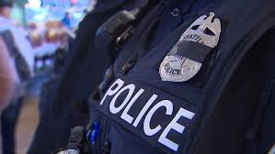
Serious Mental Illness (SMI)
Where SMI and race meet there is a legally created untenable space, where instead of pursuing life, liberty and happiness, families don’t live but navigate from crisis to crisis.
Notes:
Olmstead v. United States, 277 U.S. 438 Dissent

Slide 9
Serious Mental Illness (SMI)
Police
Structural Institutional Systemic Racism

Slide 11
Anosognosia, also called "lack of insight," is a symptom of severe mental illness experienced by some that impairs a person’s ability to understand and perceive his or her illness and need for treatment.
The symptom of the illness is that you don’t know you’re sick.
Approximately 50% of individuals with schizophrenia and 40% with bipolar disorder have symptoms of anosognosia.

Slide 12
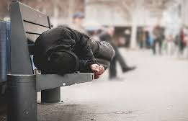
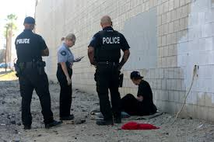
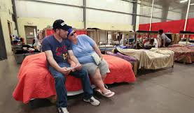
Existence is criminalized.

Slide 13
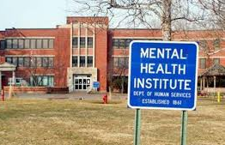
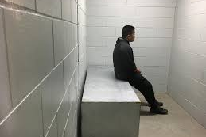
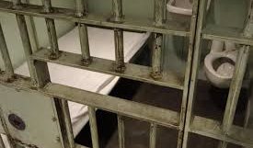
The human desire, for families and individuals diagnosed with SMI, to contribute to and engage with their community is rife with intentional and unintentional obstacles.

Slide 14
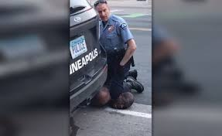
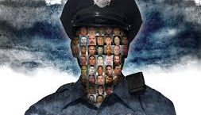
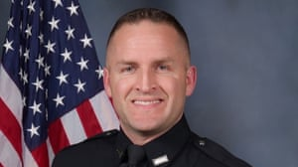
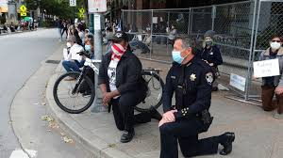
Lack of access to lawmakers. Regular engagement with law enforcement.

Slide 15
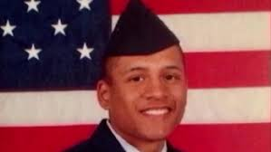
When Race and SMI collide which officers fill this untenable space?
Mental Health Crisis

Slide 16
Serious Mental Illness
Structural Institutional Systemic Racism

Slide 17
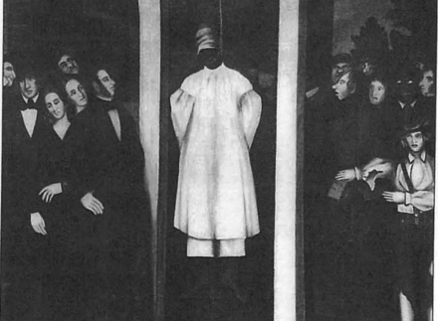
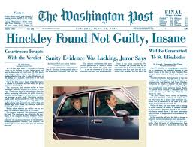
Legally Created Untenable Space

Slide 18
Community Mental Health Cen­ters (CMHC) Movement of 1963

Slide 19
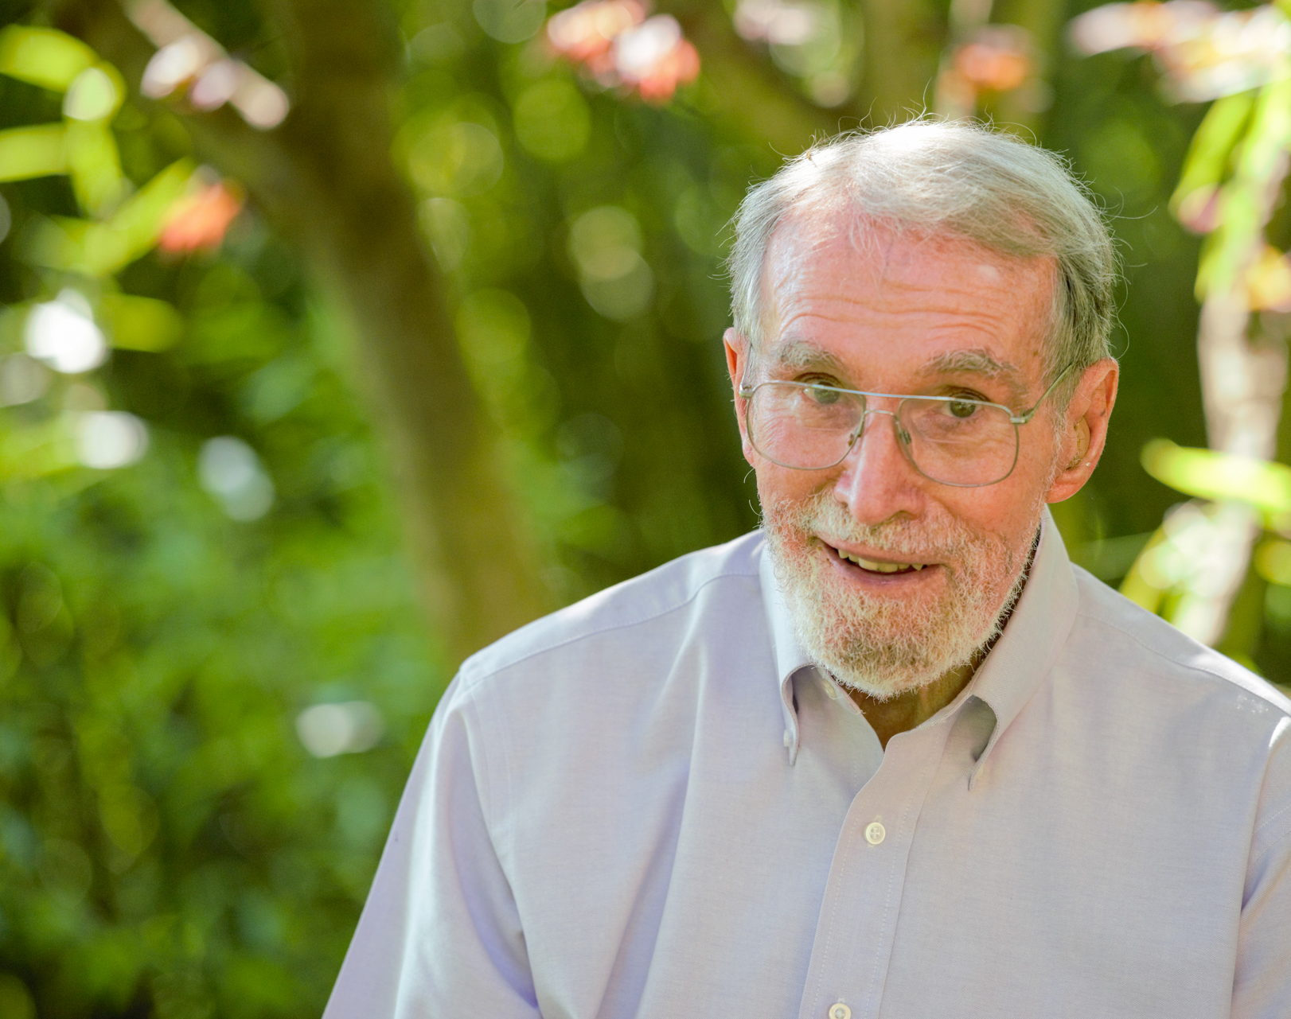
“Nobody on the commit­tee understood the role of state hos­pitals and explained to the members that these hospitals played a role “in protecting the public, and in protecting mentally ill individuals from being victimized or becoming homeless,” (p 45) or their function “as asylums in the original sense of the term” (p 45). No study examined what would happen after emptying state hospitals. Dr. Torrey, American Psychosis

Slide 20
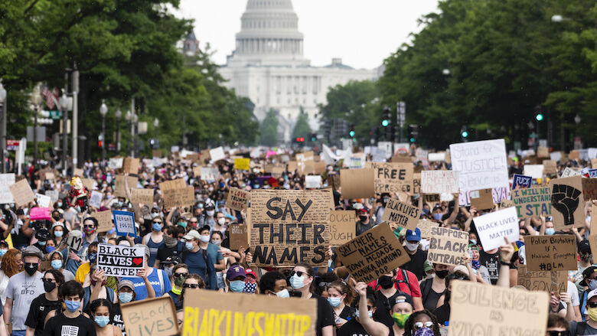

Slide 21
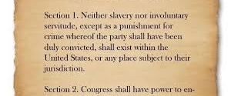
Liberty v Untenable Space
13th Amendment

Slide 22
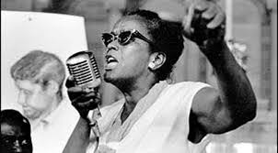
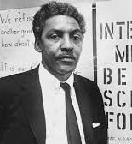
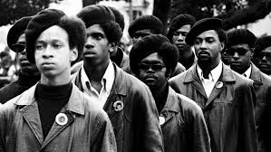
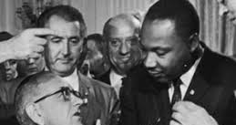
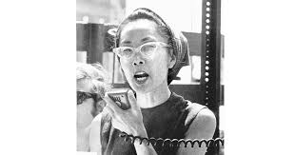
Liberty v Untenable Space
Civil Rights Act 1964

Slide 23
Instead of living life, black people navigated legally created untenable space.

Slide 24
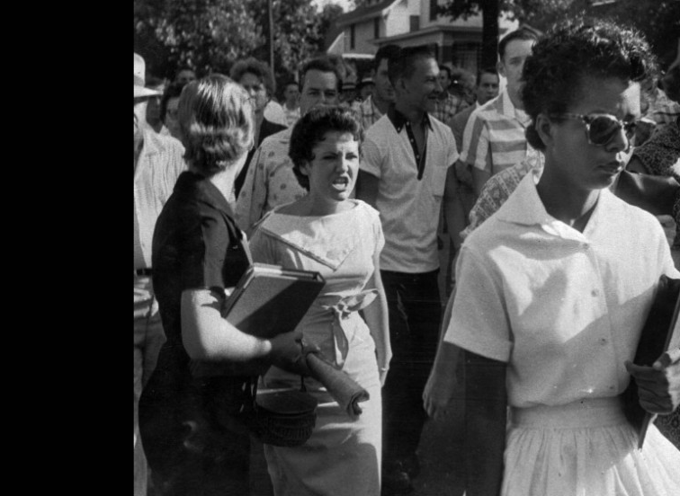
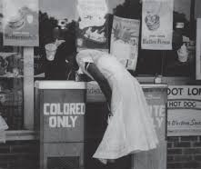
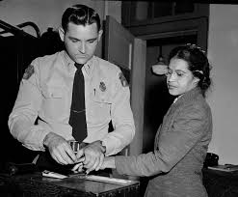
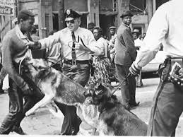
Limited access to advocates and lawmakers
Regular engagement with law enforcement.
Attempts to thrive in this untenable space trigger police engagement and the daily practice of existence is criminalized.
The majority does not experience a problem, as a result there is no problem. The problem is crisis.

Slide 25
Solutions and Next Steps

Slide 26
Break the cycle - Adopt policies that allow for; treatment before tragedy, of sufficient duration with a focus on long-term well-being. Adopt policies that make biased training mandatory and continuous. Support laws and practices that work to take SMI out of the hands of officers as sole responders. Take full responsibility what you love and what you don’t know.

