Slide 1
Significant Recent Texas Mental Health Legislation & Proposals for 2021
November 20, 2020
Prof. Brian Shannon

Slide 2
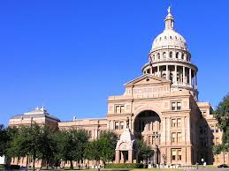
Key Statutory Enactments – 2017 & 2019
S.B. 1326 & S.B. 1849 – procedural changes
S.B. 292 & H.B. 13 – matching grants
S.B. 362
H.B. 601
S.B. 562

Slide 3
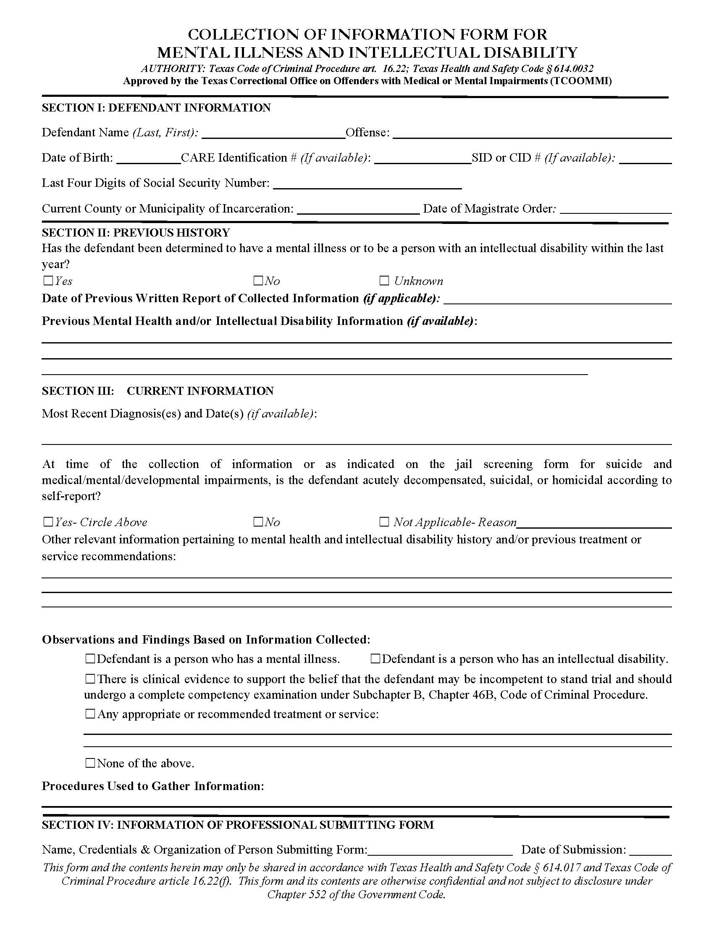
Emphasis on Early Screening and Diversion
Article 16.22
Article 16.23
Magistration
Notes:
Re 46B - 45 pages in new bench book; 85 pages in my new edition; see Chris Lopez charts on the last 3 pages of the BB

Slide 4
Article 16.22: Early Identification
Shorter time frames
12/72/96 (or 30)

Slide 5
16.22 Reports: Opportunities
17.032 Personal Bonds with Treatment Conditions
16.22(c)(5) – Diversion Roadmap for Transfer
Does the offense “involve an act, attempt, or threat of serious bodily injury to another person”?
Notes:
Re 46B - 45 pages in new bench book; 85 pages in my new edition; see Chris Lopez charts on the last 3 pages of the BB

Slide 6
Funding for State Hospitals and Matching Grant Programs
Inpatient Construction
Funds for additional programs

Slide 7
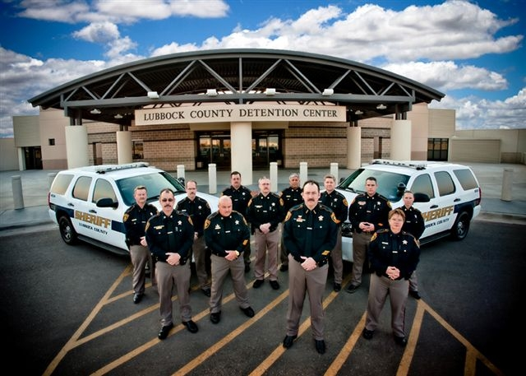
Competency Restoration: Initial Restoration
Chapter 46B now includes possibilities for inpatient, outpatient, and jail-based competency restoration
Practical challenges to outpatient and jail-based services
Created the framework for the future!
Notes:
BB pp. 133-138

Slide 8
Competency Restoration - Alternatives
Outpatient Competency Restoration – 13 OCR Programs in Texas (at present)
Jail-Based Competency Restoration – 5 JBCR programs
Continuing pressing need given waitlists.
Notes:
The 12 are listed in BB on p. 134

Slide 9
Competency Restoration: Return to the Court
Prompt action is needed
Avoid decompensation
Per Article 32A.01, the trial of a criminal action against a defendant who has been determined to be restored to competency shall be given preference over other matters before the court, whether civil or criminal (except for criminal cases in which the alleged victim is under the age of 14).
Notes:
BB pp. 144-146

Slide 10
Other Key Reforms
● Maximum security placement?
● More Mental Health Courts?
● Clarification of Civil Commitment provisions in the H&S Code
Notes:
BB p. 117

Slide 11
Resources
● The Bench Book – texasjcmh.gov
● Shannon Guide (6th) – namitexas.org

Slide 12
Texas Judicial Mental Health Commission – 2021 Proposals
Criminal Justice
S.B. 362 Emergency Detention
https://www.txcourts.gov/media/1449778/criminal-justice-committee-2020_0923_final.pdf

Slide 13
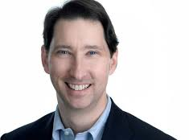
Legislative Research Task Force
● Diversion: 16.22
● Diversion: Oath & Promise to Appear
● Psychiatric Stabilization at a Jail
● Aligning Expert Qualifications for 46B & 46C
● When to start counting days?
● Good Time Credits re OCR
● Clarifications to JBCR – 46B.091
Chair, Justice Bill Boyce
Notes:
BB p. 117

Slide 14
Justice & Municipal Courts
● Lack of Capacity –
Class C Misdemeanors
● Competence to Plead –
Class C Misdemeanors
Notes:
BB p. 117

Slide 15
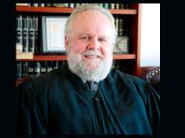
S.B. 362 Task Force
● Peace Officers and Waiting at a Facility
● Electronic Applications for ED warrants
● Seizure of Firearms
● Blood draws
● Delaying arrest?
Chair, Judge Brent Carr
Notes:
BB p. 117

Slide 16
Thank you!
Notes:
BB p. 117

