Slide 1
The Evolving State of Mental Health Care in Texas and
Its Impact on the Courts
John Petrila, JD, LLM | Senior Executive Vice President of Policy
November 20, 2020

Slide 2
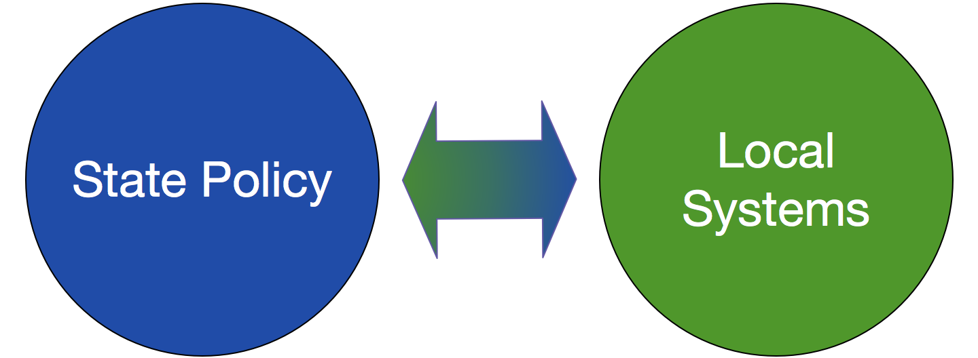
Meadows Mental Health Policy Institute
Mission Statement
To provide independent, non-partisan, and trusted policy and program guidance that creates systemic changes so all Texans can obtain effective, efficient behavioral health care when and where they need it.
Vision
We envision Texas to be the national leader in treating people with mental health needs.

Slide 3
Sites of MMPHI Assessments

Slide 4
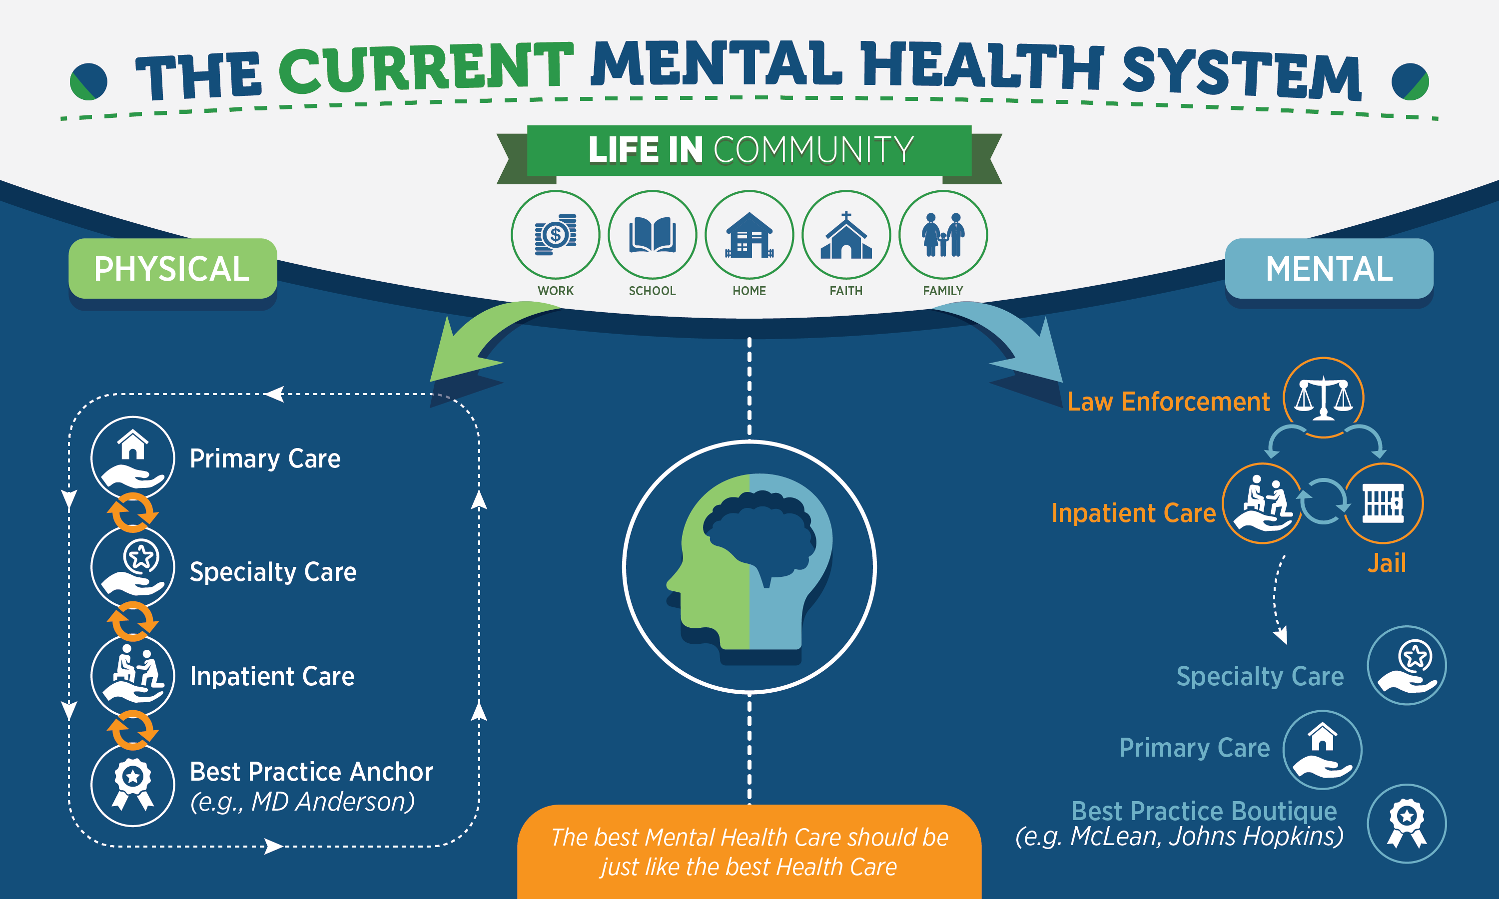
We Treat the Brain Differently From the Body
Notes:
This is the original slide.

Slide 5
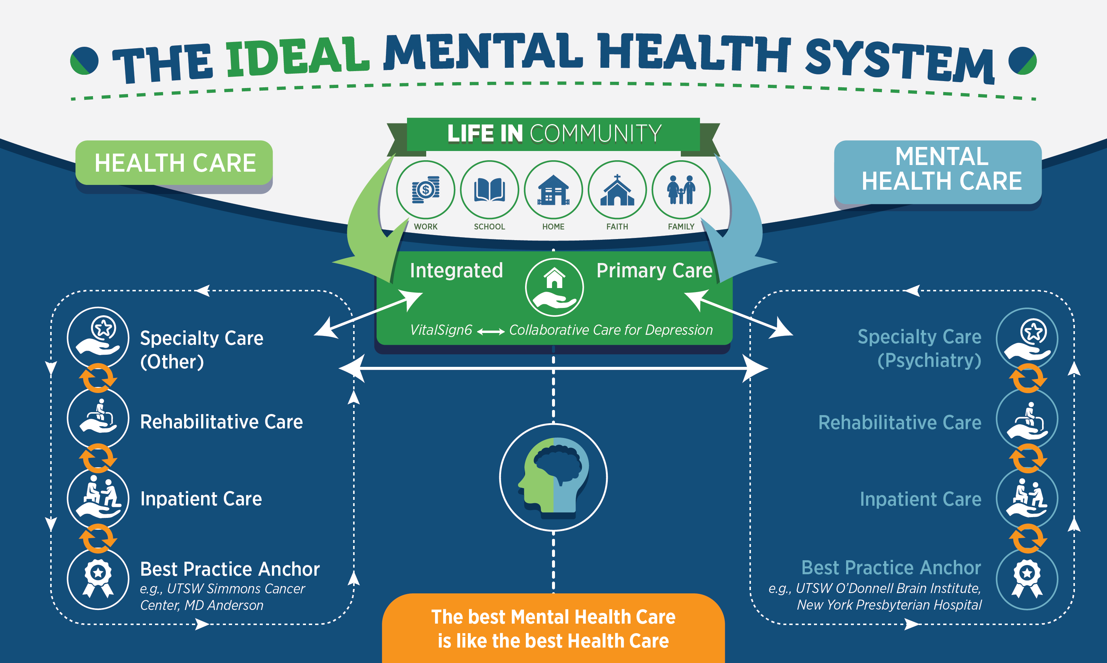
The Ideal System: Integrated Care

Slide 6
Four Assertions for Today
The role of the courts has changed fundamentally and is more important than ever
The important innovations of the last two decades have led us into an unintended impasse
The application of constitutional principles has deepened that impasse
We can only keep people out of the justice system by making health systems equal partners in reform

Slide 7
The State Chief Justices and the Changing Role of Courts
Judges are particularly well positioned to lead reform efforts because of their unique ability to convene stakeholders (Resolution 11, in Support of the Judicial Criminal Justice/Mental Health Leadership Initiative, 1/18/2006)
The Conference of Chief Justices encourages each Chief Justice to take a leadership role to address the impact of mental illness on the court system through a collaborative effort involving stakeholders from all three branches of government
These efforts continue through the establishment by the Board of Directors of the Conference of Chief Justices and Conference of State Court Administrators in March 2020 of a new Task Force “to assist state courts in their efforts to more effectively respond to the needs of court-involved individuals with serious mental illness”

Slide 8
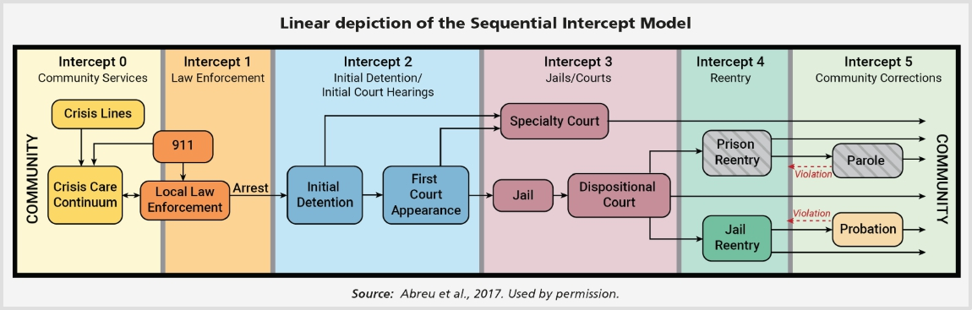
The Sequential Intercept Model as a Tool for Innovation

Slide 9
What is the Size of the Population?
One estimate is that 2 million people with mental illnesses are booked into jails annually
Prevalence for major mental illnesses is 3 times higher for men (6.4% v. 1.8) and twice as high for women (20.4% v. 10.6%) in jail than in the general population
As many as 14.2% of offenders in confinement suffer from a major mental illness
More than one million persons with mental illness in the US in jail, in prison, on probation, or on parole

Slide 10
Primary Responses Have Been Inside the Justice System
CIT Programs (Intercept 1)
Mental Health Bond (Intercept 2)
Specialty Courts (Intercept 3)
Specialty Probation (Intercept 4-5)

Slide 11
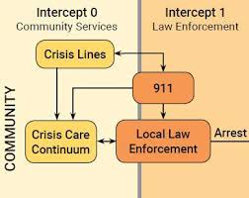
Intercept 1: CIT
Widely adopted nationally
  (2,700 programs)
Law enforcement reliant
Outcomes:
  Modest effect on diversion to services
  Good effect on police attitudes
  Diversion programs may decrease justice
  costs while increasing health costs
  http://jaapl.org/content/early/2019/09/24/JAAPL.00386319#:~:text=Despite%20a%20lack%20of%20evidence,area%20of%20officer%2Dlevel%20outcomes.

Slide 12
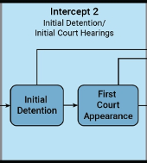
Intercept 2: Mental Health Bond
Texas law emphasizes identification of persons with mental illnesses in jail
Not later than 12 hours after the sheriff or municipal jailer having custody of a defendant for an offense punishable as a Class B misdemeanor or any higher category of offense receives credible information that may establish reasonable cause to believe that the defendant has a mental illness or is a person with an intellectual disability, the sheriff or municipal jailer shall provide written or electronic notice to the magistrate. CPP 16.22

Slide 13

Screenings in Relation to Number of Assessments

Slide 14
One Jail’s Experience
County Jail Process Stage | Process Stage | Number
Number Screened Positive at Jail Intake | Number Screened Positive at Jail Intake | 1,407 (June to September 2020)
Number of CCP 16.22 Assessment Completed | Number of CCP 16.22 Assessment Completed | 701 (May 21, 2020 to Sept 30, 2020)
Defendants Accepted GCC Intake | Defendants Accepted GCC Intake | 199
Completed GCC Intake in Jail | Completed GCC Intake in Jail | 93
Completed GCC Intake and Released from Jail | Completed GCC Intake and Released from Jail | 48
GCC Intake, Release from Jail and Completed First Psychiatry Visit or Has Scheduled Future Visit | GCC Intake, Release from Jail and Completed First Psychiatry Visit or Has Scheduled Future Visit | 14

Slide 15
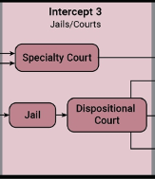
Intercept 3: Specialty Courts
350-400 mental health courts nationally
Median caseload is 36
Some impact on recidivism for those completing court
There is no national model for a mental health court
There is significant variation in type
  To find mental health courts anywhere in the US, see https://www.samhsa.gov/gains-center/treatment-court-locators

Slide 16
Summing Up the Evidence
“There is, at best, mixed evidence that these programs as a whole reduce recidivism”
The evidence base seems weakest for mental health-based models and for jail diversion programs
The evidence for recidivism reduction is mixed but not quite as weak for models emphasizing supervision by specialized courts or probation officers
Symptom control does not seem related to reduced recidivism for most individuals
  Jennifer Skeem, et al, http://riskresilience.berkeley.edu/sites/default/files/attachments/projects/2011.correctional-policy-for-offenders-with-mental-illness.pdf

Slide 17
What is the Appropriate Response?
For a small number of offenders, mental illness is correlated with criminal offending: Services may be useful
For a much larger number of offenders, criminogenic risk factors explain criminal offending and the mental illness is incidental to offending
For the latter group, apply evidence-based correctional approaches based on the Risk-Need-Responsivity (RNR approach)
This requires an effort to better sort offender cohorts

Slide 18
Our Justice Based Interventions
Reach small groups of people
Have mixed results on recidivism and linkage to treatment
We arguably have gone from under-identifying to over-identifying persons with mental illness thereby reducing effectiveness
MMHPI assessments routinely find
  Non-integrated crisis responses
  Little step down from jail to care
  An over emphasis on hospital beds as the solution

Slide 19
Traditional Tools Are Now Part of the Problem
The Constitution mandates consideration of competency to stand trial and 45 states still use the insanity defense
The insanity defense is used infrequently
Competency to stand trial is used increasingly
  For misdemeanor cases
  As a reflexive tool by defense counsel
Richard Bonnie argues that “the two traditional legal pathways to treatment in the criminal justice system are useless or counterproductive”

Slide 20
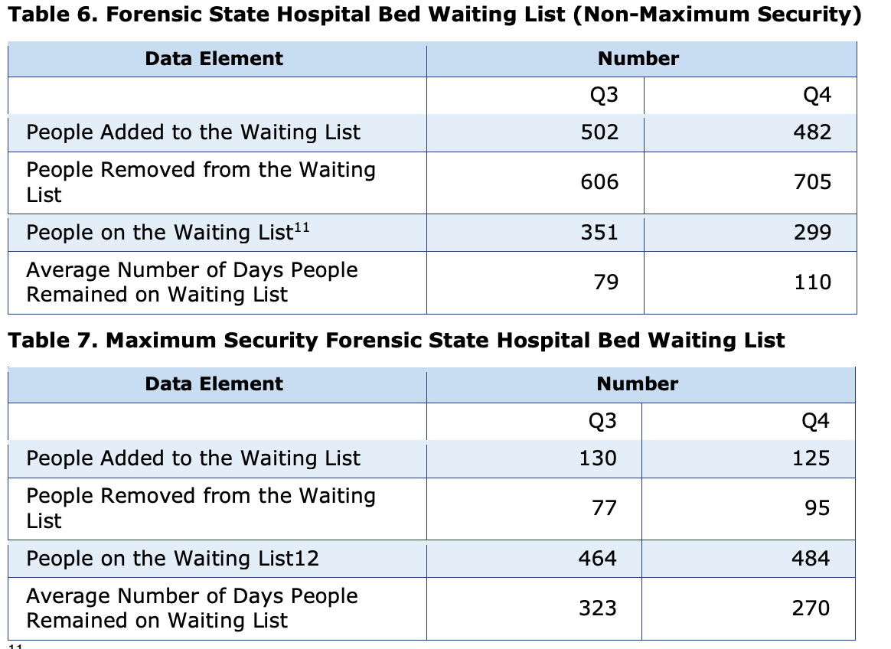
When Small Numbers Cause Large Problems

Slide 21
Can We Rethink Competency?
Jail and outpatient competency restoration is a start
Texas law now permits HHSC to determine placement (maximum vs non-maximum security)
But we need to acknowledge that competency adjudications are frequently a dead-end
Virginia is considering a proposal titled “Expedited diversion to court-ordered treatment”

Slide 22
Where Should We Go?
The role of the judge as convener may be as essential as the role of judge as case-adjudicator
We cannot rely on continued refinement of strategies inside the justice system and assume we will solve the problem of too many people with mental illnesses in that system
We must include the health system as an active partner and use integrated care
We need to focus on Intercept 0

Slide 23
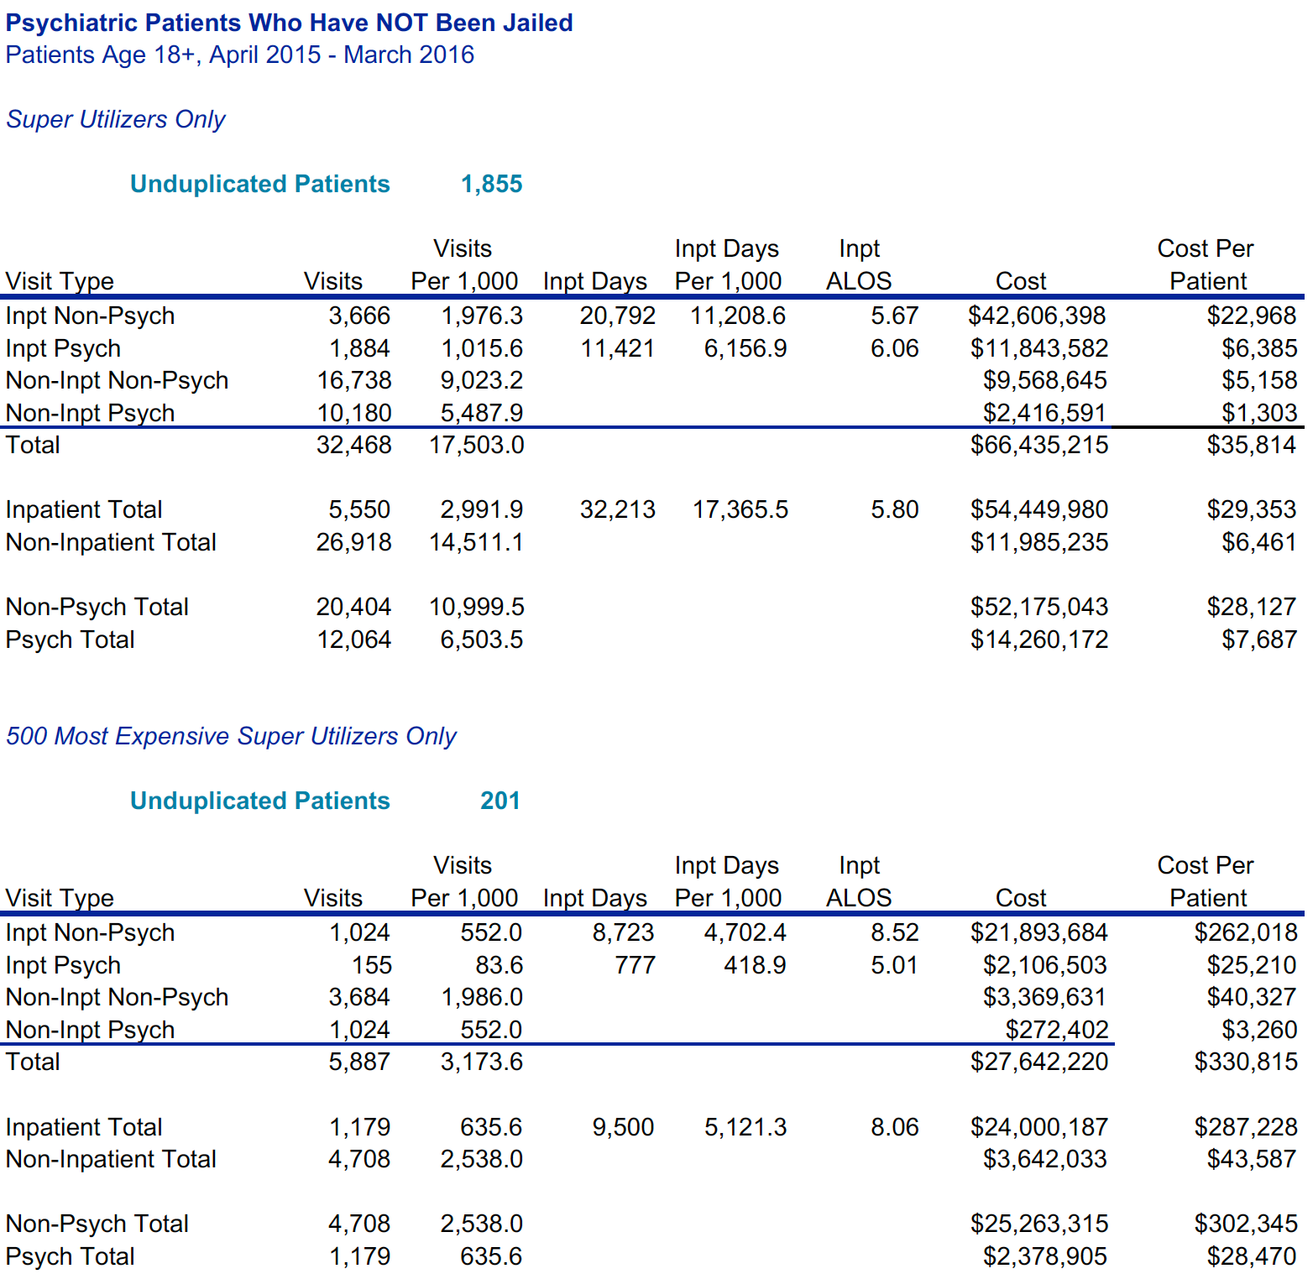
Why We Need Integrated Care

Slide 24
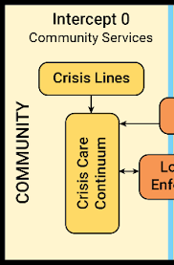
Intercept 0: Community Services
We should respond to a mental health crisis like we do a general health crisis
The best response includes a paramedic, a licensed mental health professional, and a law enforcement officer
In addition, it is important to have
  A place for assessment
  Navigation to services
  Adequate services
  A commitment to reducing emergency department use as well as jails because of psychiatric boarding
  Movement toward a collaborative care model

Slide 25
A Note About Hospital Capacity from Our Assessments
Most communities think they need more beds
Often a perception based on what else isn’t there
When we look at bed use, we find
  People often transferred out of county
  Some hospitals are reluctant to treat mental illness
  Fragmented crisis response may result in multiple movements of patients
  Issues have been exacerbated by COVID in some communities though less so in Texas
  In general, most communities have enough inpatient capacity

Slide 26
For the Future
We need to acknowledge both the positives but also the limits of two decades of innovation
Continued refinement of strategies that are inside the justice system will have limited effect
Health systems are essential to the future of local system development and transformation
Judges play an essential role as convenors and levers of change and this role is more important than ever

